Slide 1

The eco-sustainable hexapod
Conner Lewis (Engr 1201)

Slide 2
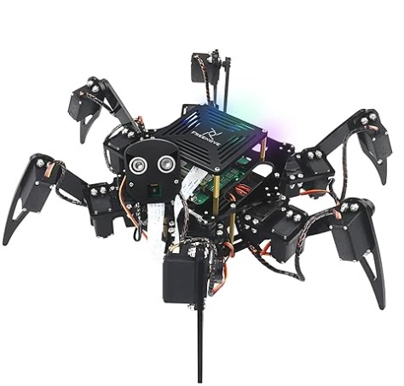
Arduino Based Hexapod
I assembled the freenove hexapod robot kit that includes an Arduino based system. Utilizing microcontrollers for joints, the motion sequences use C++ coding language. The hexapod was then equipped with a recycling bin repurposed from a Sunfounder Arduino kit, filled with nano boards, and paired with a recycling outpost.

Slide 3

Engineering Justification
This project was driven by my long-standing passion for robotics and my current interest in Arduino-based systems. It taught me how robotics can play a vital role in addressing global challenges like trash management and recycling.. I sought to challenge myself by building my first hexapod robot which not only deepened my understanding of the C++ coding language but strengthened overall my programming logic. Additionally, I hope to inspire others to create and challenge themselves in similar ways.

Slide 4
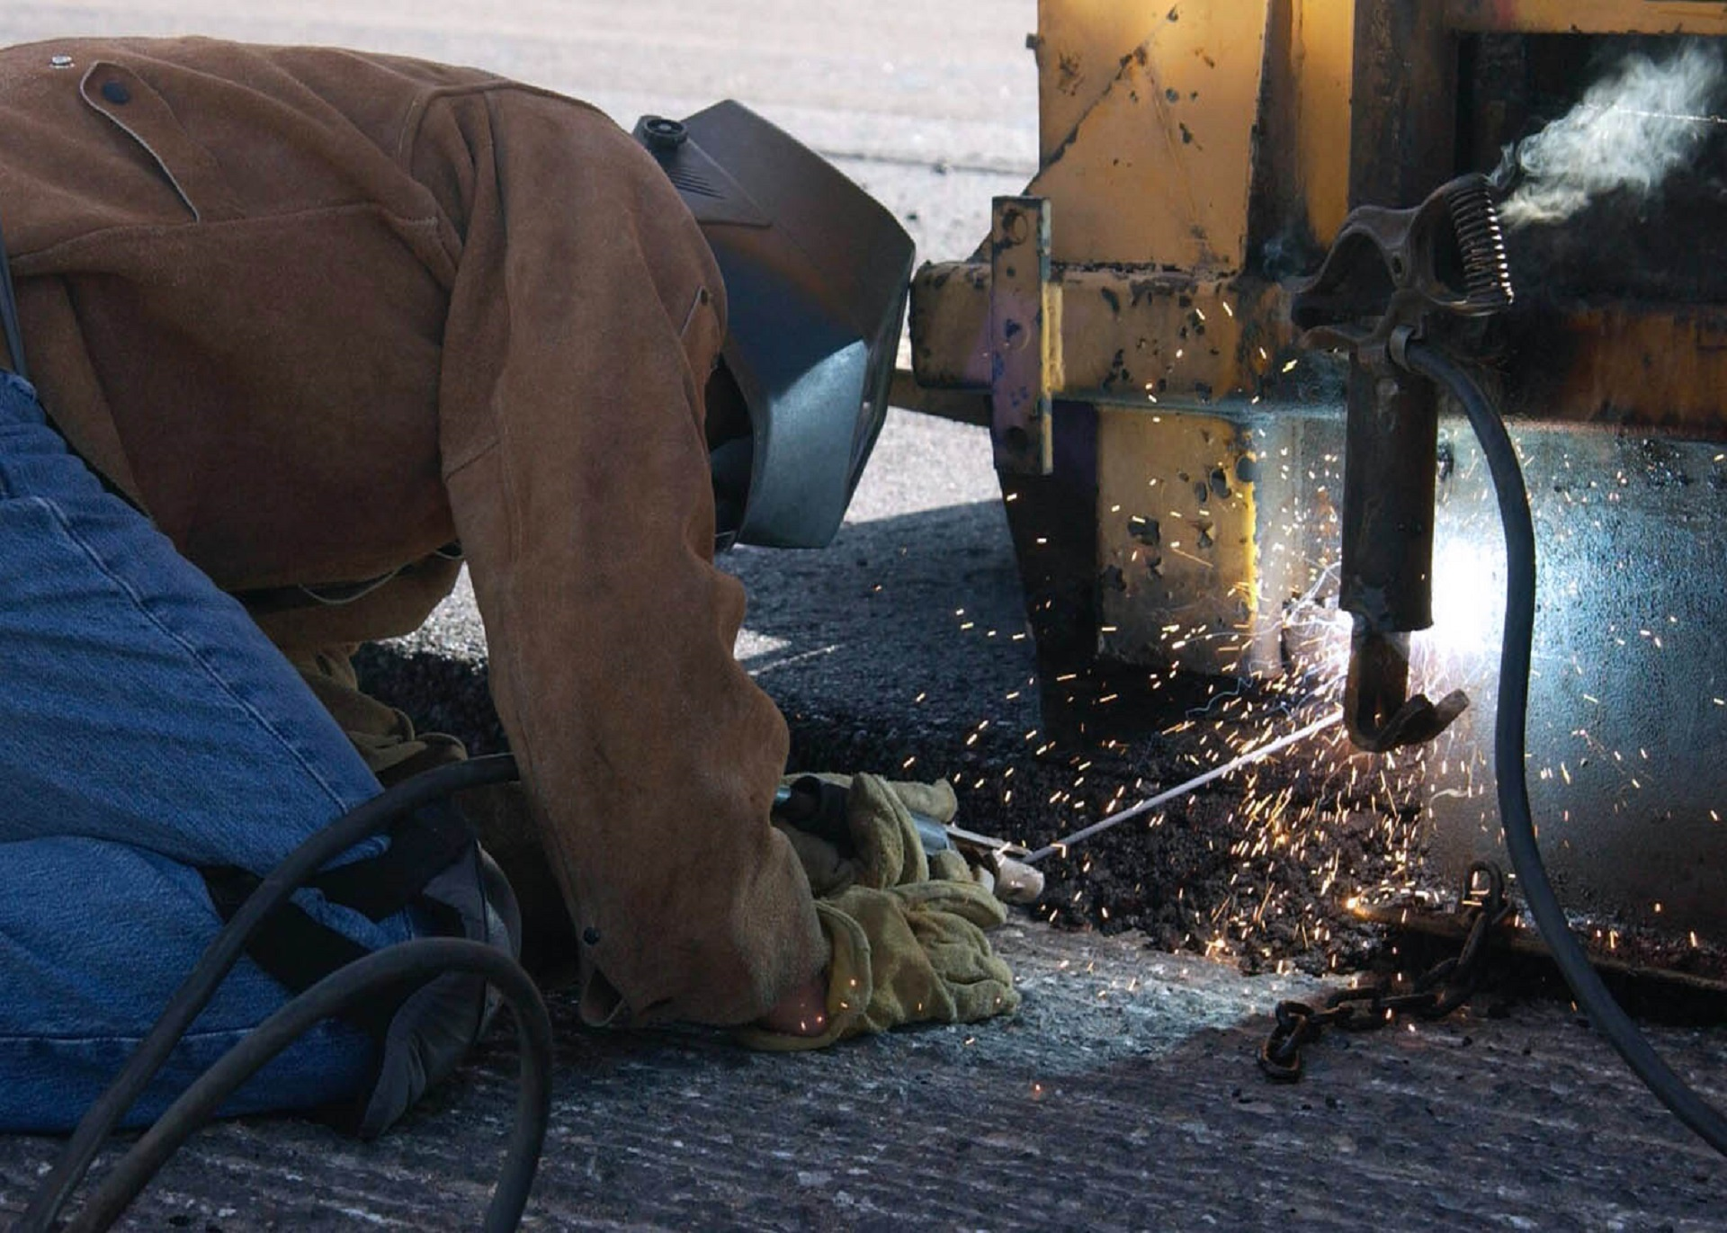
Hardware components
Materials Used:
Acrylic Components:
Acrylic plates
Mechanical Parts:
Screws
Brass standoffs
Nuts
Dynamic Parts:
Servo micromotors
Electronic Components:
WLAN module
USB cable
Hexapod controller
2× 18650 repurposed lithium-ion flat-top batteries
Repurposed Nitecore lithium-ion charger

Slide 5


Hardware components/Sustainability Tie in
Materials Used:
Recycled Components:
Amazon packaging
SunFounder Arduino kit packaging
Repurposed Nano boards
Zipties
Hexapods excel in the robotics world when it comes to navigating difficult terrain. With six legs for enhanced stability, they can traverse rocky surfaces and trash-filled environments with ease. This makes them ideal for tasks like beach cleanup, hazardous needle collection, and even e-waste cleanup.

Slide 6

Thank You

